Slide 1
Lesson 1 – What is a computer program?
MaREI Python Course – September 2022
Cathal Hoare

Slide 2
Lecture Contents
Welcome
What is a program?
Writing an Algorithm
Tools of the Trade

Slide 3
Welcome!
Welcome to Computer Science and Western Gateway Building
Outside of the lab, I can be found in G.67 (corner of building by river and on western end).
I can be reached on 087 2413643
In case of a building emergency…
Labs aren’t secure…don’t leave valuables alone.
Other essentials

Slide 4
What do you hope to achieve?
Tell me about you:
  How much programming have you done?
  What would you like to take away from the course?

Slide 5
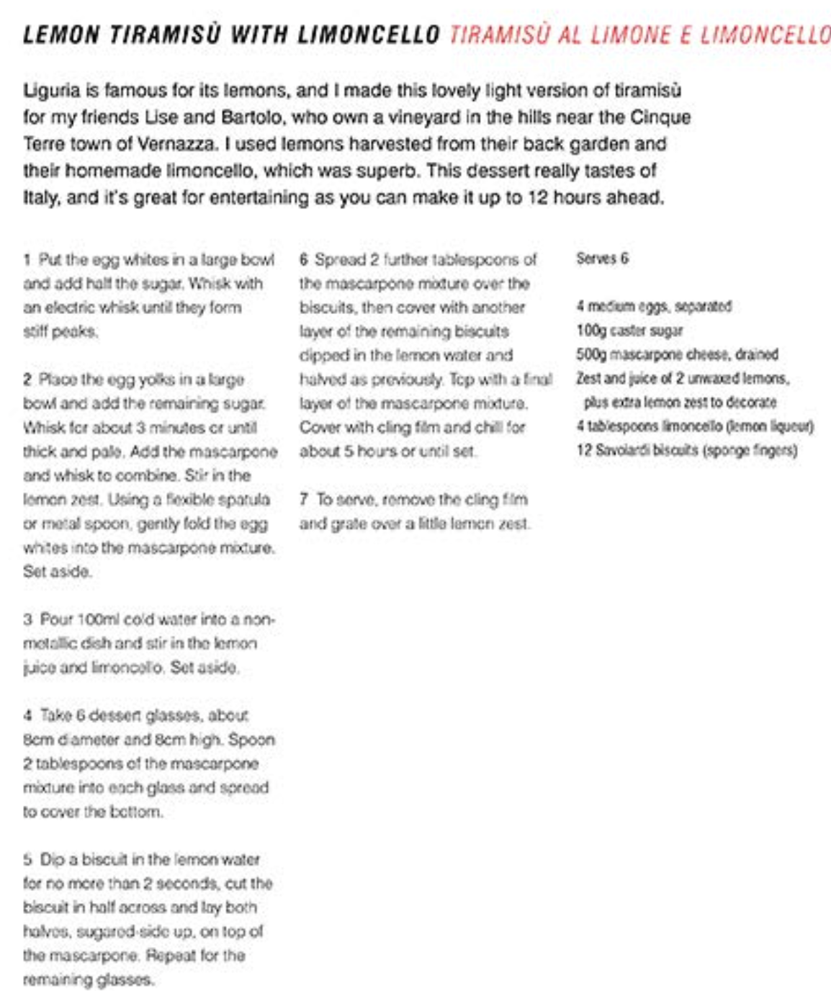
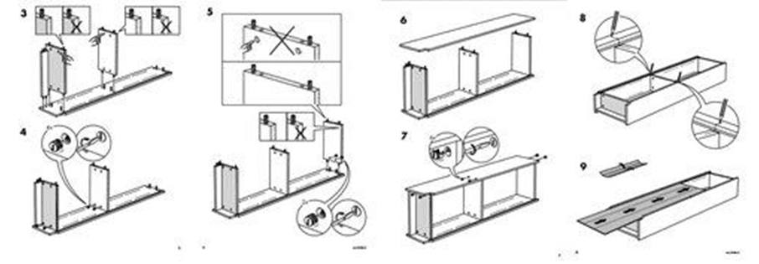
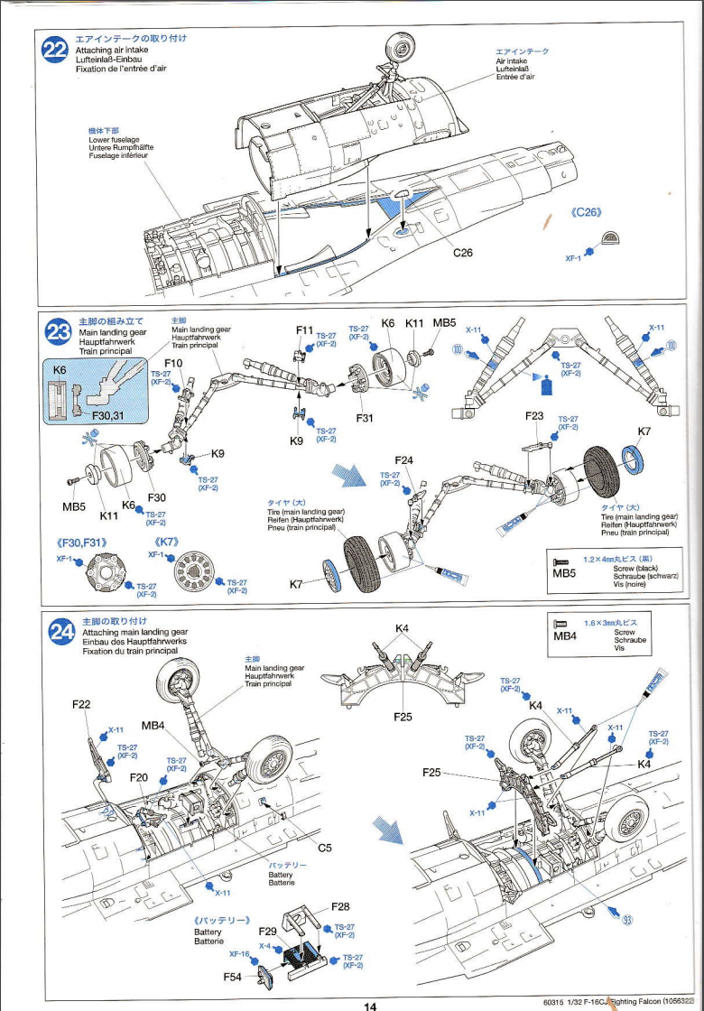
About Cathal

Slide 6
Thinking about programming
A program is a series of ordered instructions
  The instructions are written using an unambiguous language – in our case Python
  The instructions must be in the correct order
We need two things:
  A plan – how do we plan to tackle the problem. This can be a sketch, a set of bullet points or a more formal design methodology. This is the computational algorithm.
  A list of those instructions converted to our programming language – aka a program
  We should ALWAYS keep these as two separate tasks
We should also accept that:
  We will make lots of mistakes. We need to test, test and test some more. We should not just make sure that our code runs, but also check that it produces the correct results.

Slide 7
Thinking about programming
In the end we should aim to:
  Write code that works correctly – gives a correct answer for all circumstances encountered by the program
  Is written reasonably efficiently - it doesn’t have to be perfect, but it should be easy to understand what we are doing so that we can fix bugs later, should arrive at the correct answer with a minimum amount of code (less effort for us, easier to maintain and easier for the computer to run)
  Shouldn’t break anything else – our code may run as part of a system – always consider the affect our code has on the system.

Slide 8
Why should I know about programming?
Much of our life is influenced by software – its nice to understand the process of how it works
Programming is a useful skill – it allows us to do interesting and useful things
In non-software careers, its empowering to understand the process. Invariably, you will encounter systems and need to discuss some technical issues
It can be great fun and very satisfying

Slide 9
To be a good programmer
Practice problem solving – more than anything else!
Learn a language
Understand the work that others have done, and how you might be able to use it
Know the tools that are available to you

Slide 10
Solving a problem…
Pick a prominent key
Check if the key fits
if the key fits see if it turns
  if the key turns, you’ve found the key
  otherwise try the next key by repeating

Slide 11
Tools
Here we looked at a set of tools:
  Microsoft Visual Studio Code
  Github
  Anaconda and virtual enviornments
  Websites like Pypi and pip

Slide 12
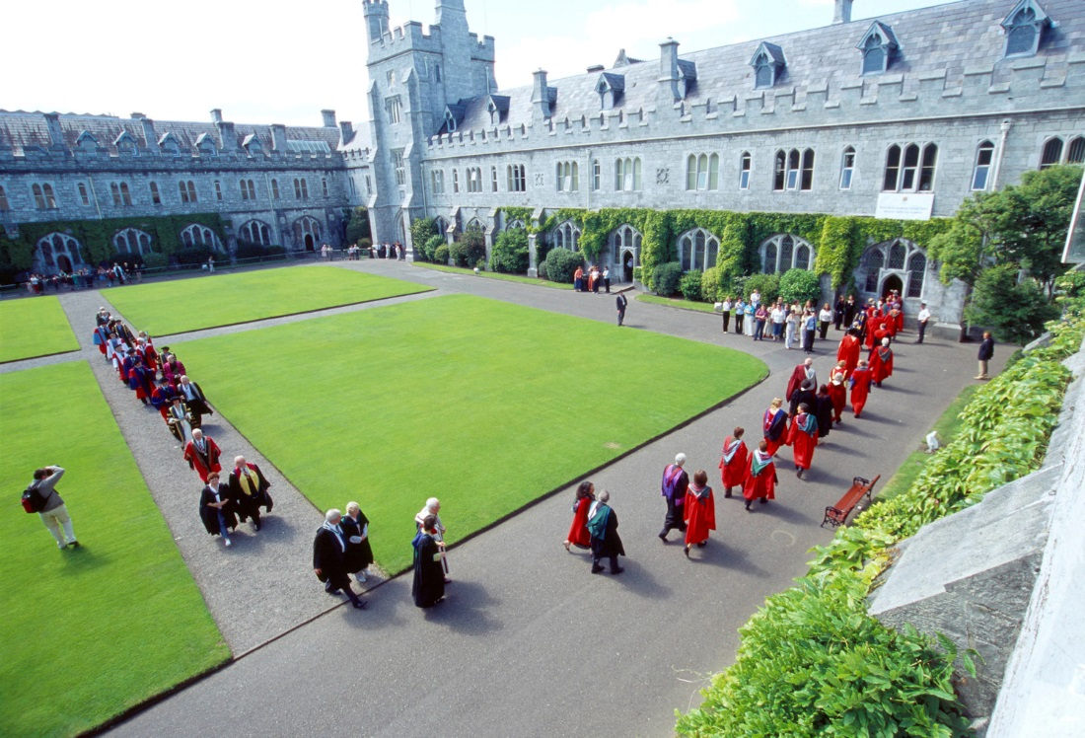
Next : Writing some code!

